Slide 1
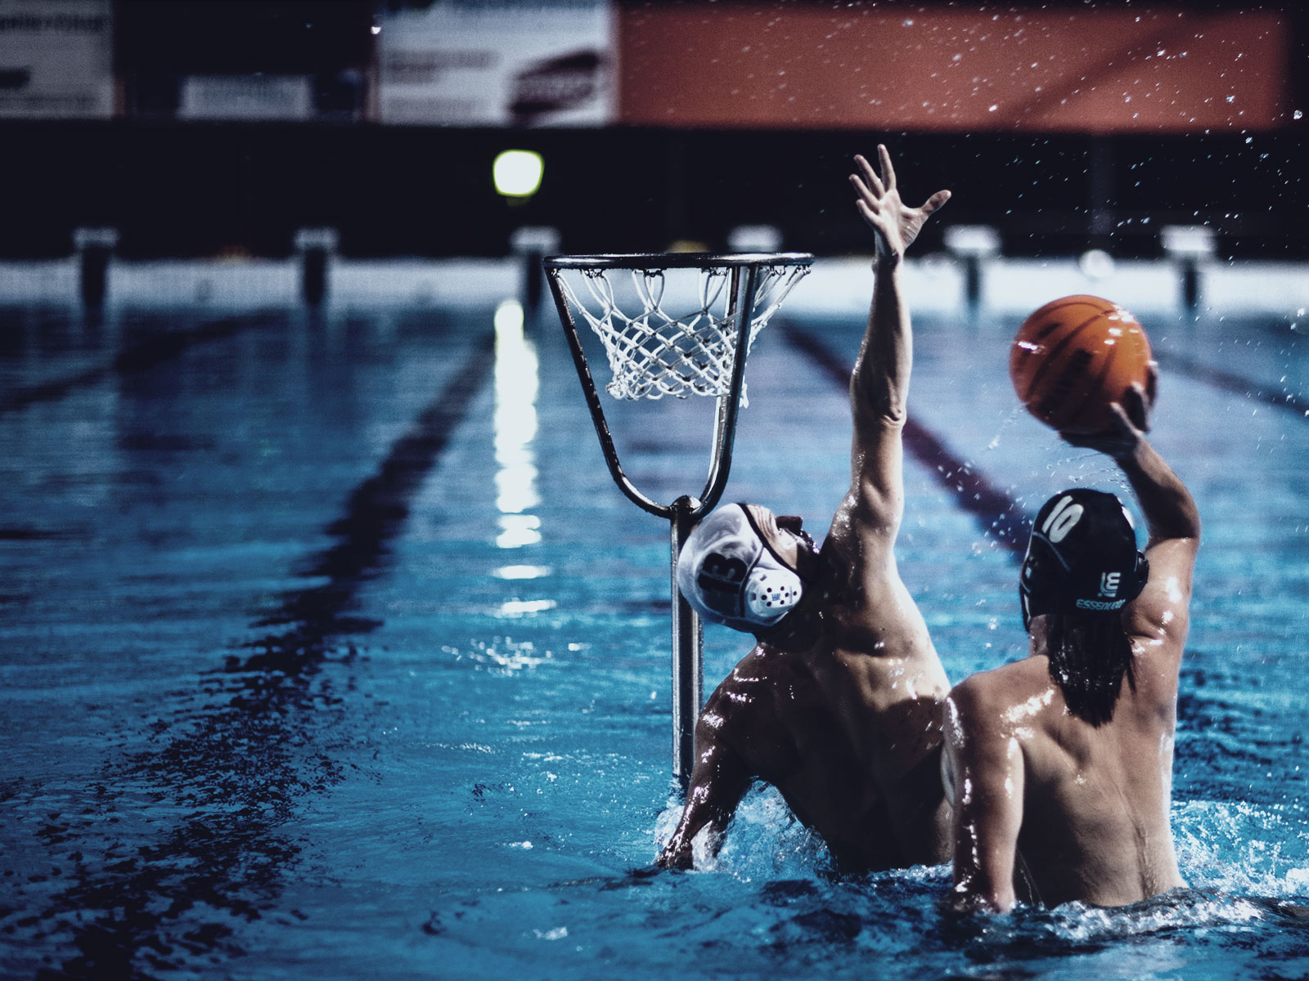
WATERBASKETBALL
New attractive water sport

Slide 2
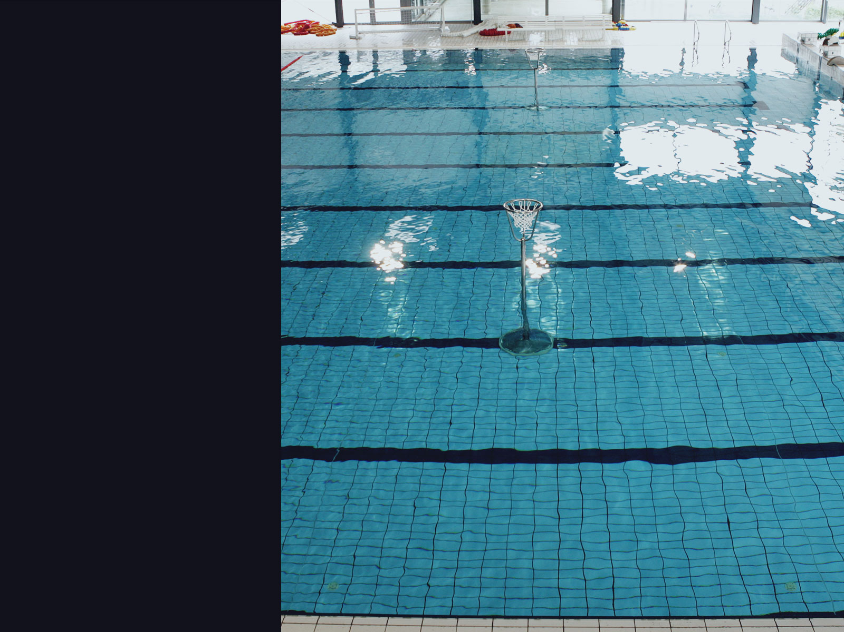
It‘s about water
A playing court should be 25 m long and 12,5 m wide
The distance between baskets is 13 m
Each of them is standing 6 m of the court edge
Minimum depth should be at least 1,8m in all parts of the court

Slide 3
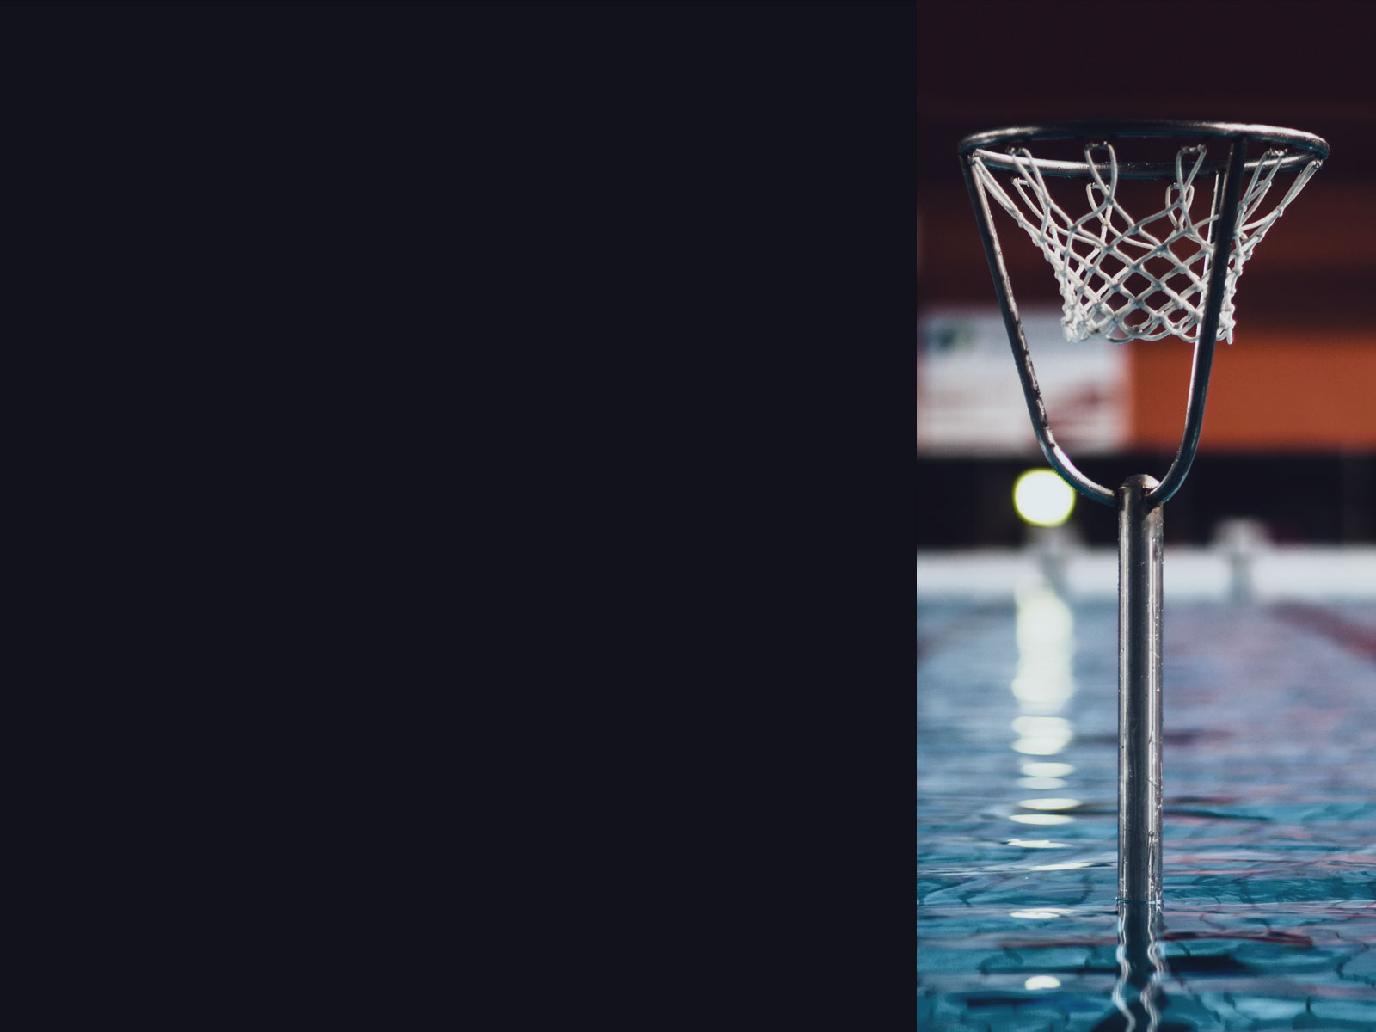
It‘s about a basket
The basket is free standing
It stands on the ground of the court
The ring of the basket is 1,05 m above the water surface

Slide 4
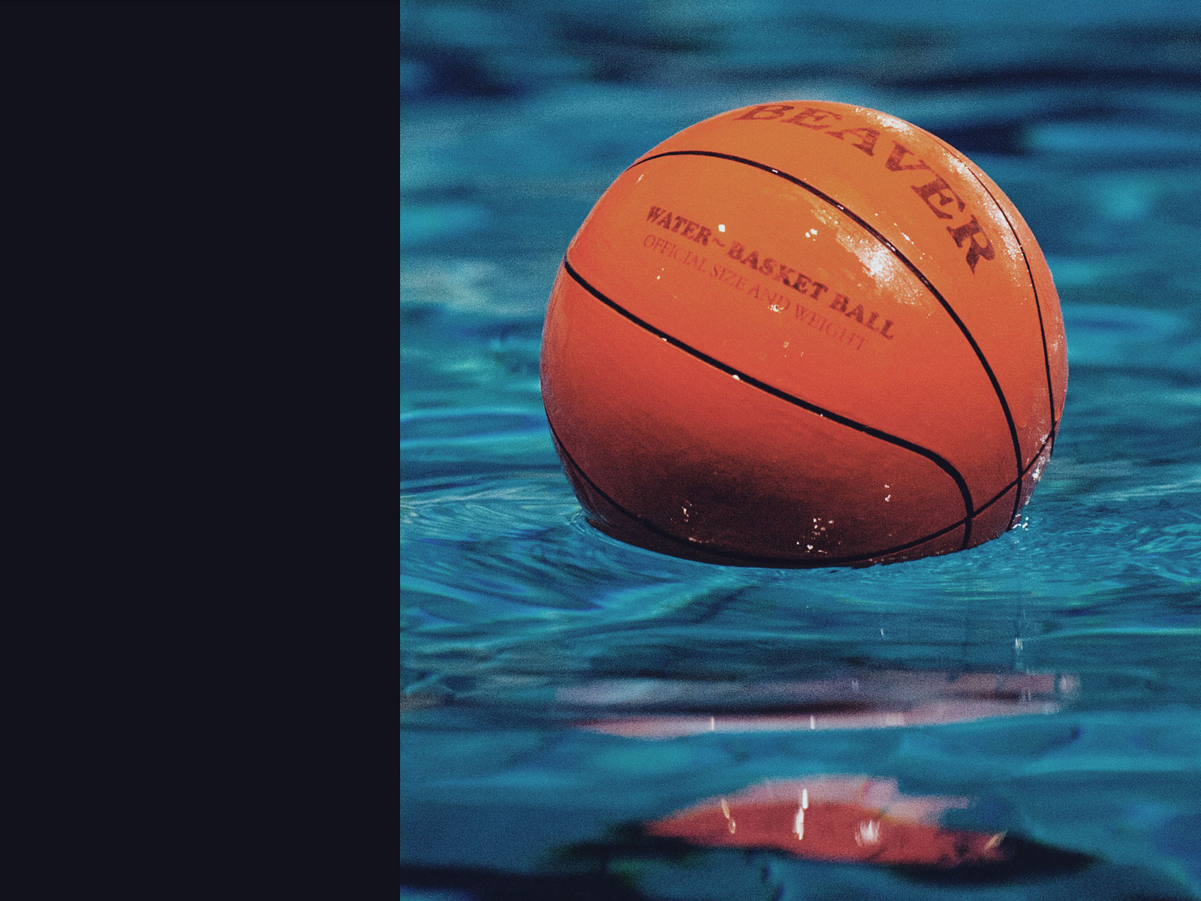
And
a ball
It‘s orange with a characteristic basketball pattern
It has 71 cm circumference and weight‘s 500 g

Slide 5
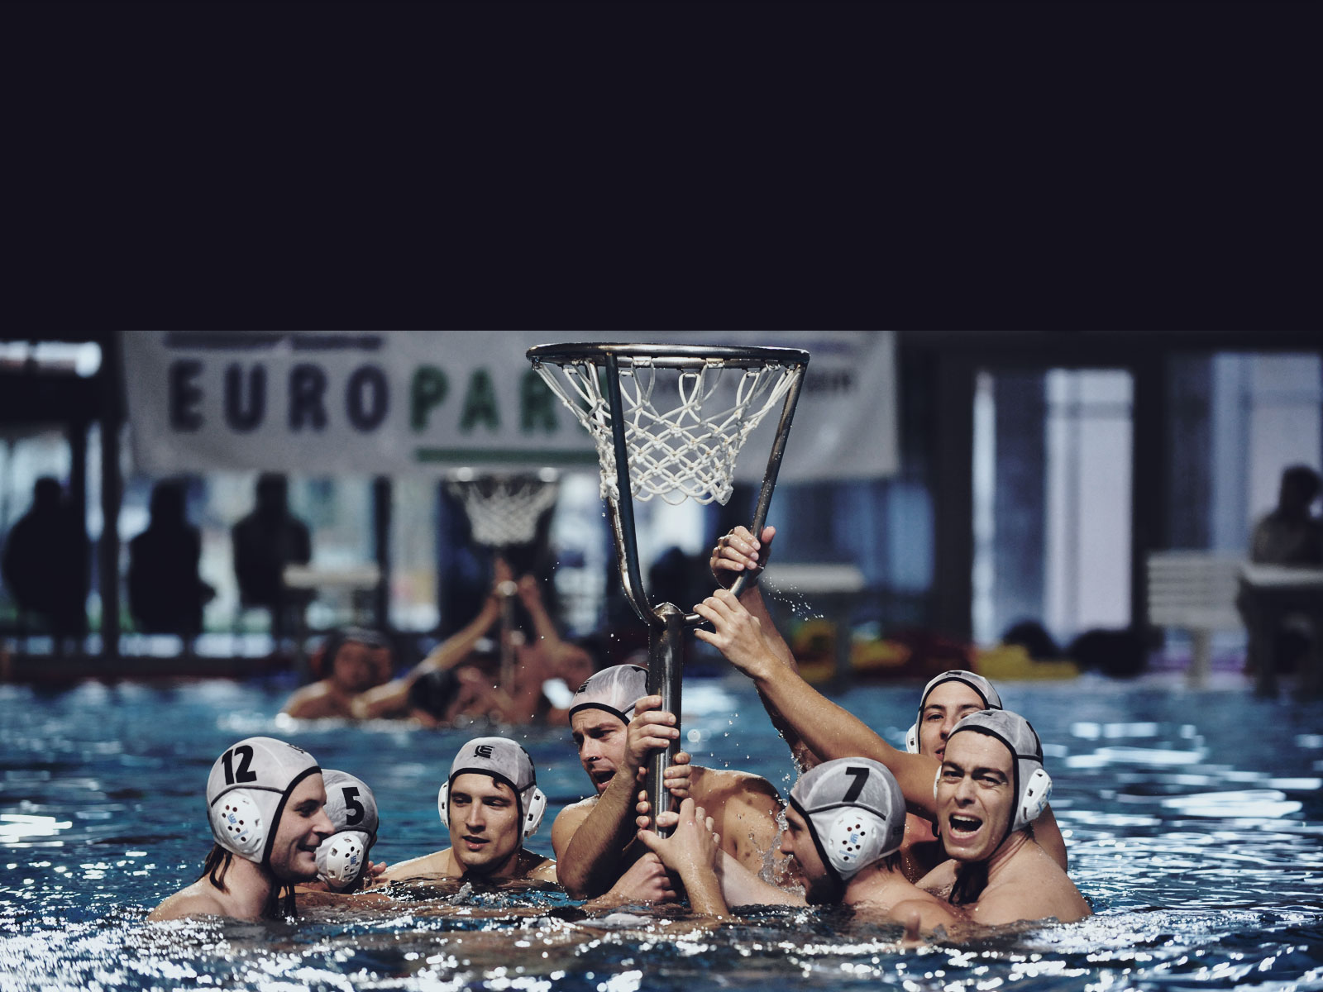
Each team consists of maximum 10 players
During the game, there are 5 players from each team in the court

Slide 6
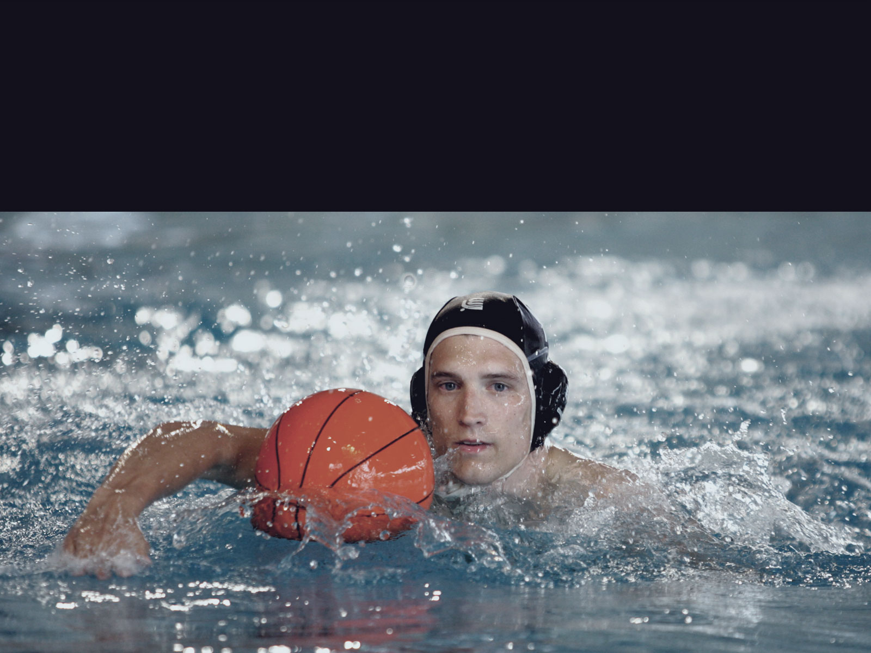
Three things to play
Swimming - with fast sprints and quick water starts

Slide 7
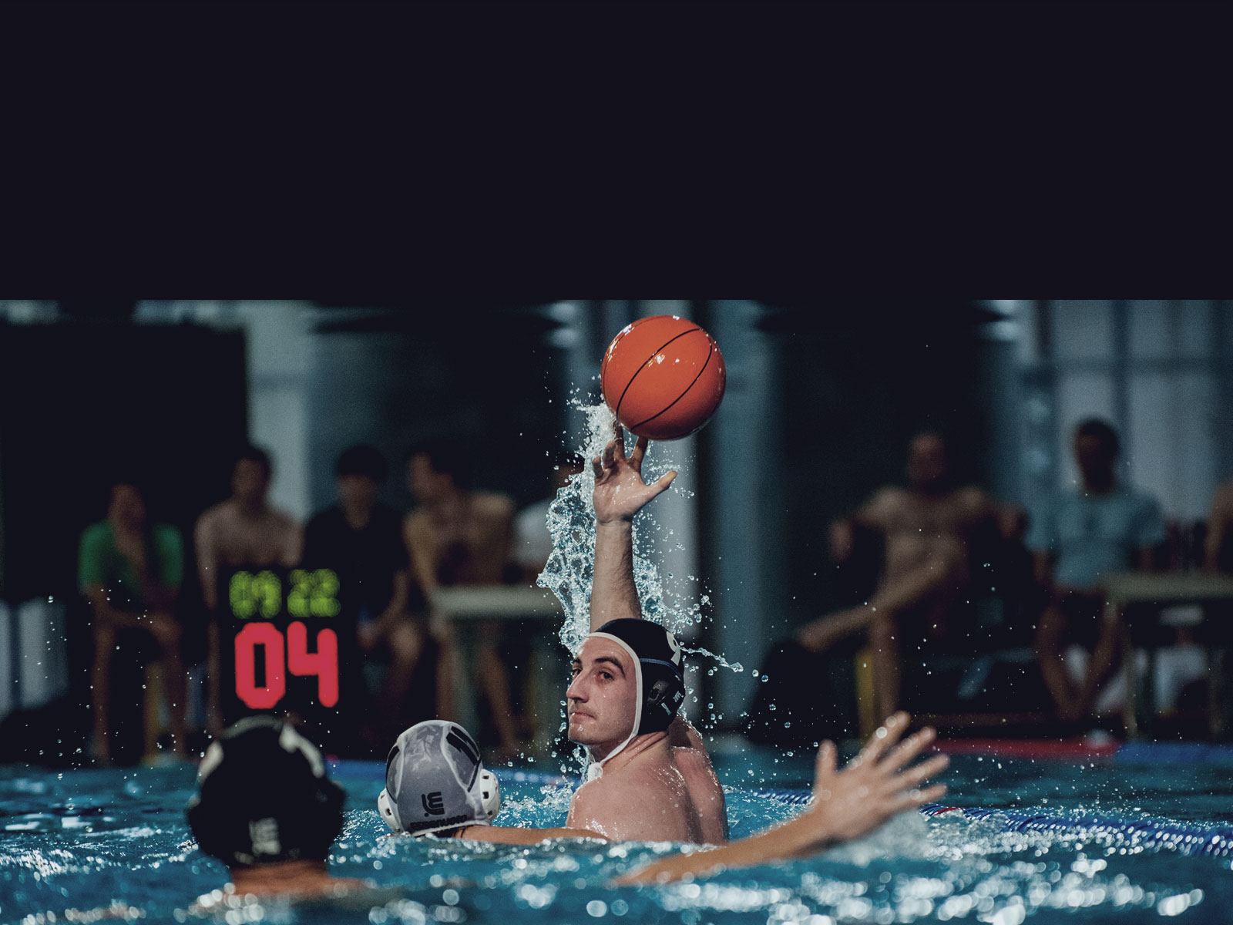
Three things to play
Passing the ball - with both or one hand

Slide 8
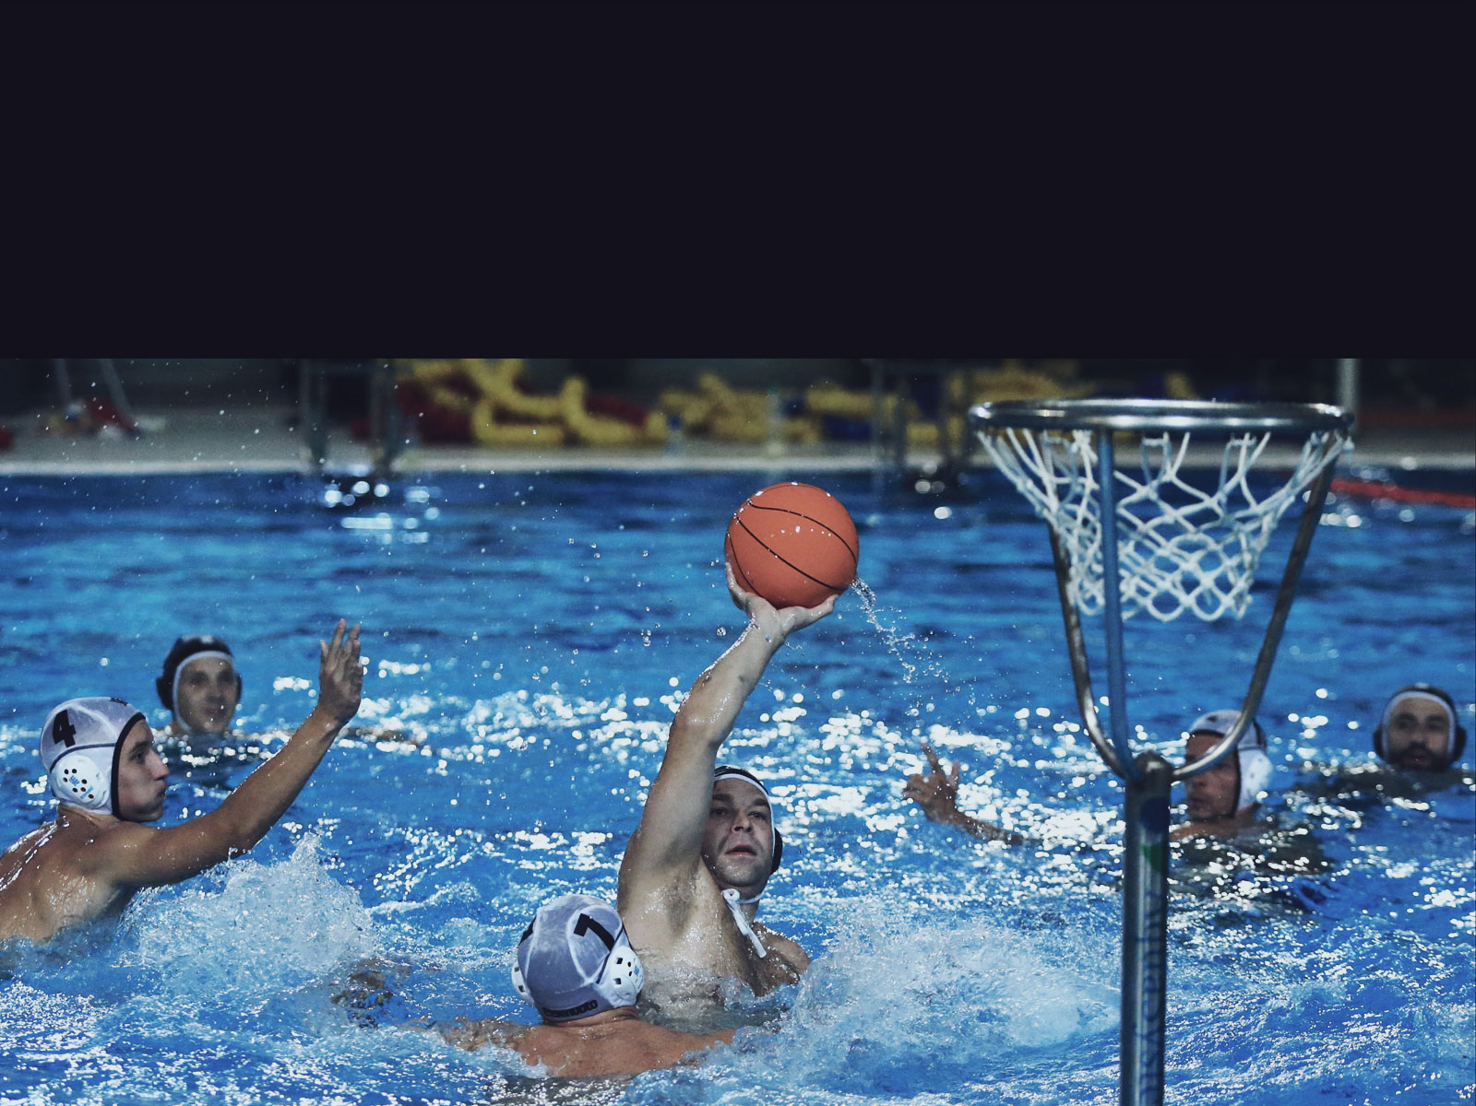
Three things to play
Scoring a goal (basket)

Slide 9
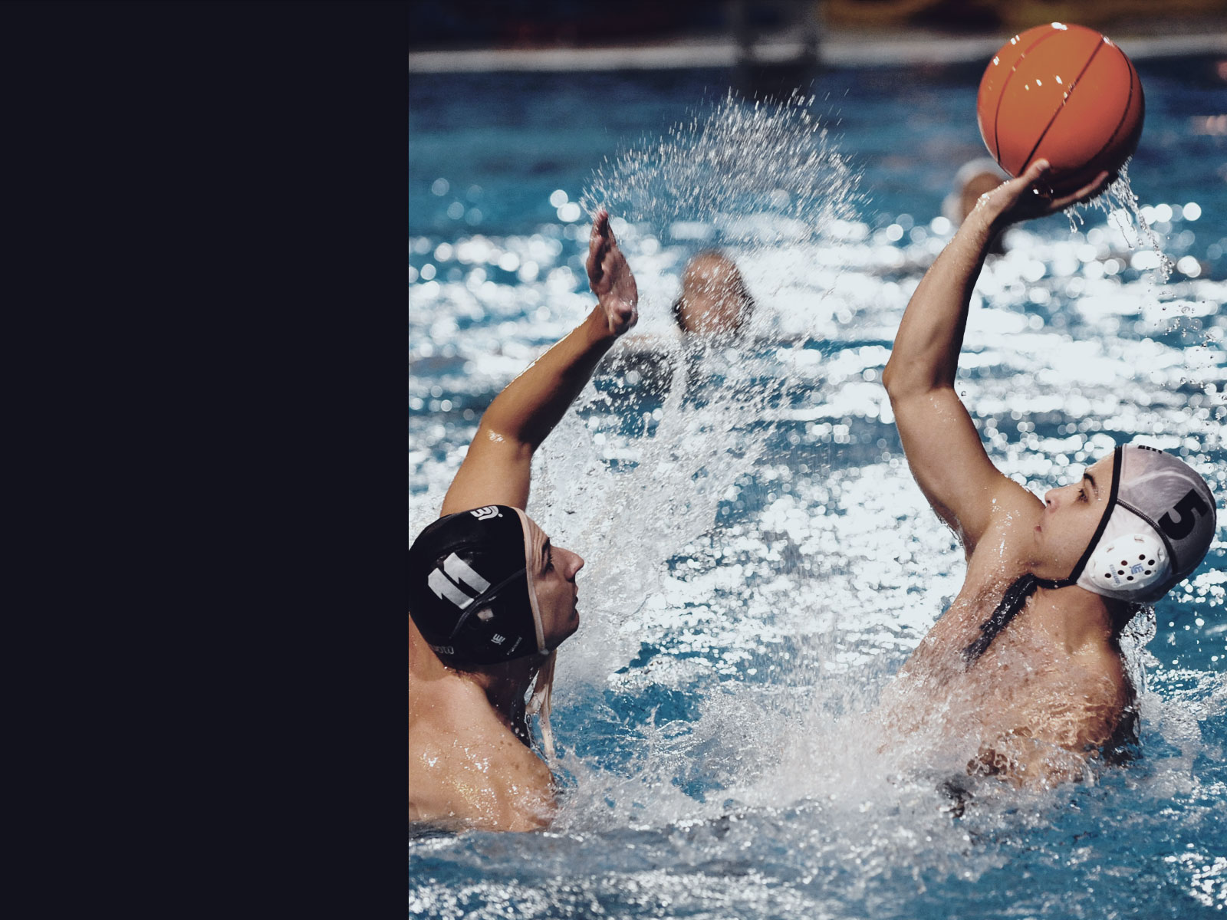
Fall -
away

Slide 10
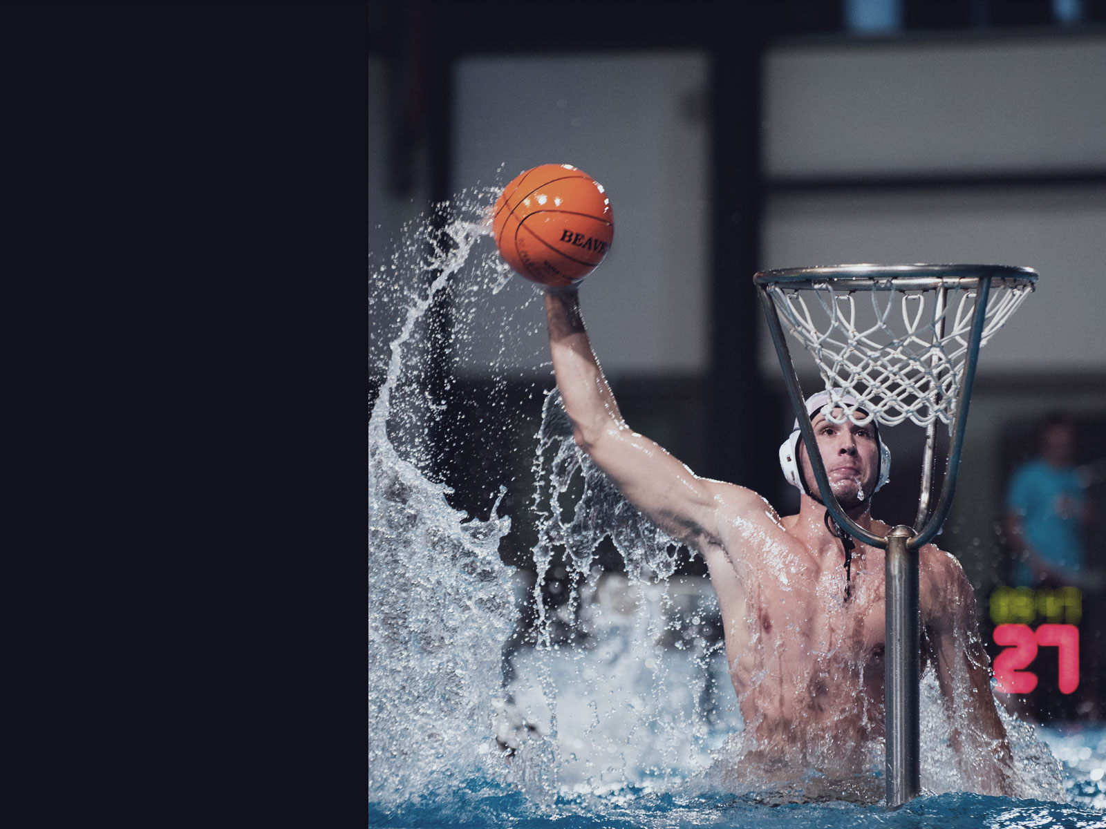
Slam
dunk

Slide 11
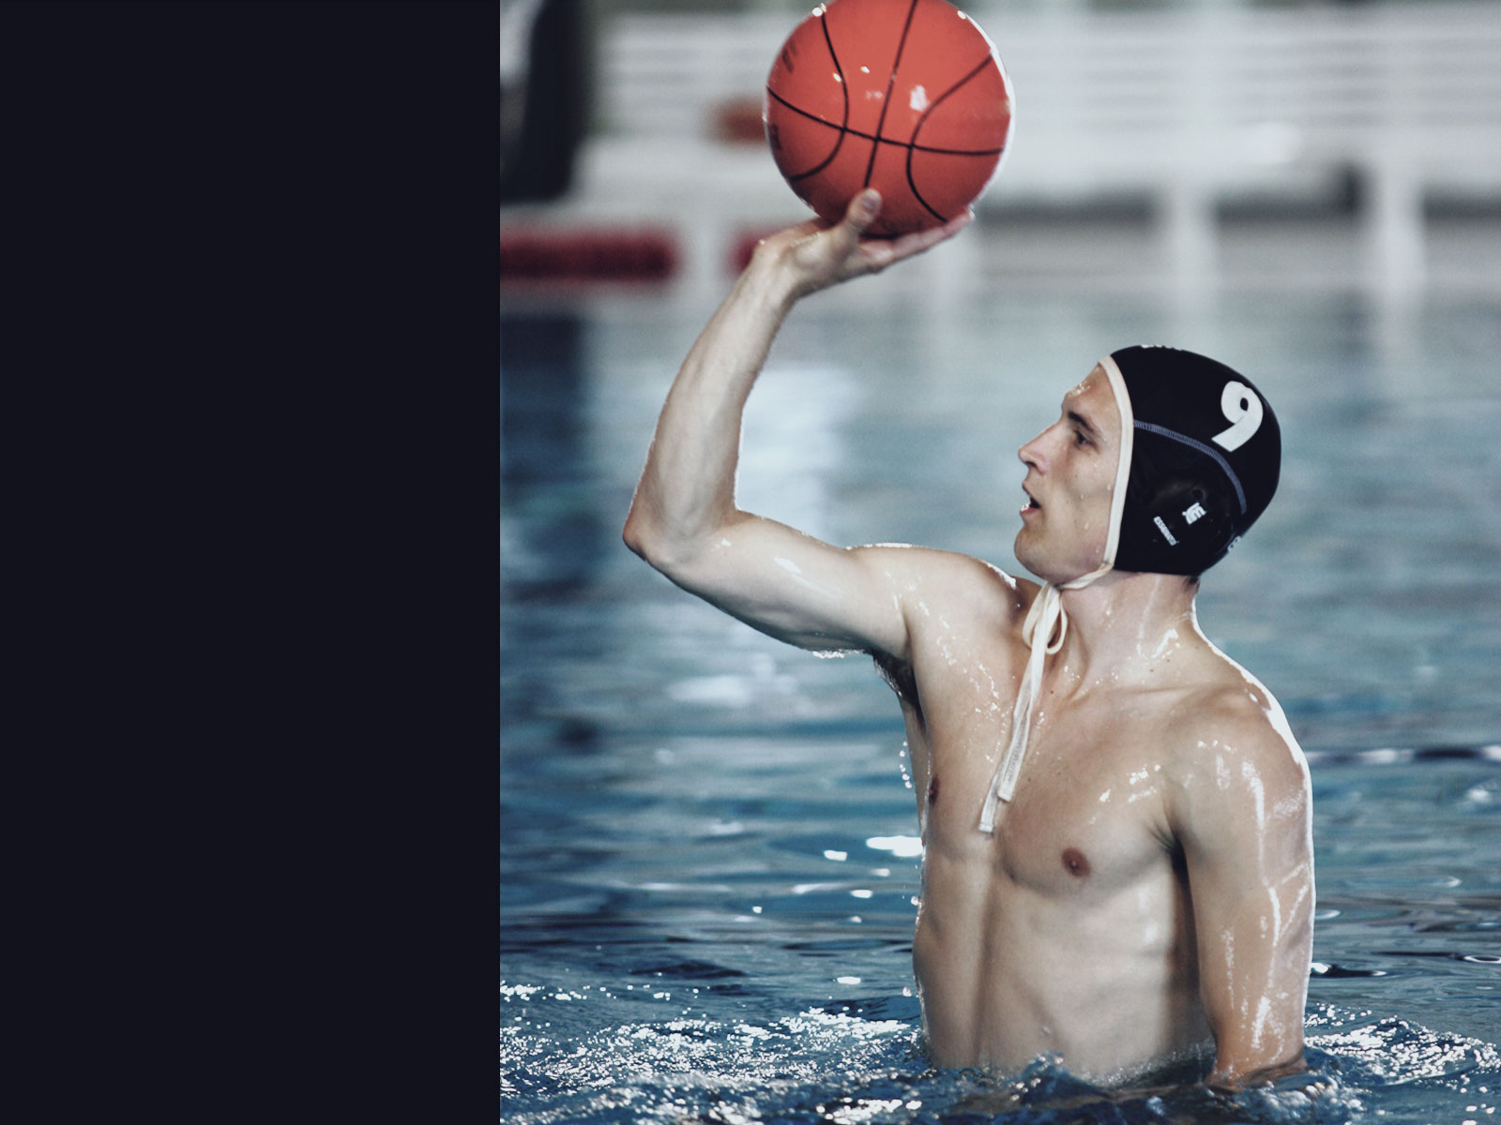
Precision and control
Scoring a goal (basket) requires a balanced position on the water, a well coordinated movement of the legs, body and arms
Furthermore it demands a very precise hand and great focus

Slide 12

Waterbasketball is about team-work
There are 5 players trying to get the best opportunity for a single player to score
Skill and technique of every individual is crucial for success
Tactics are as important as technique in gaining advantage in the game

Slide 13
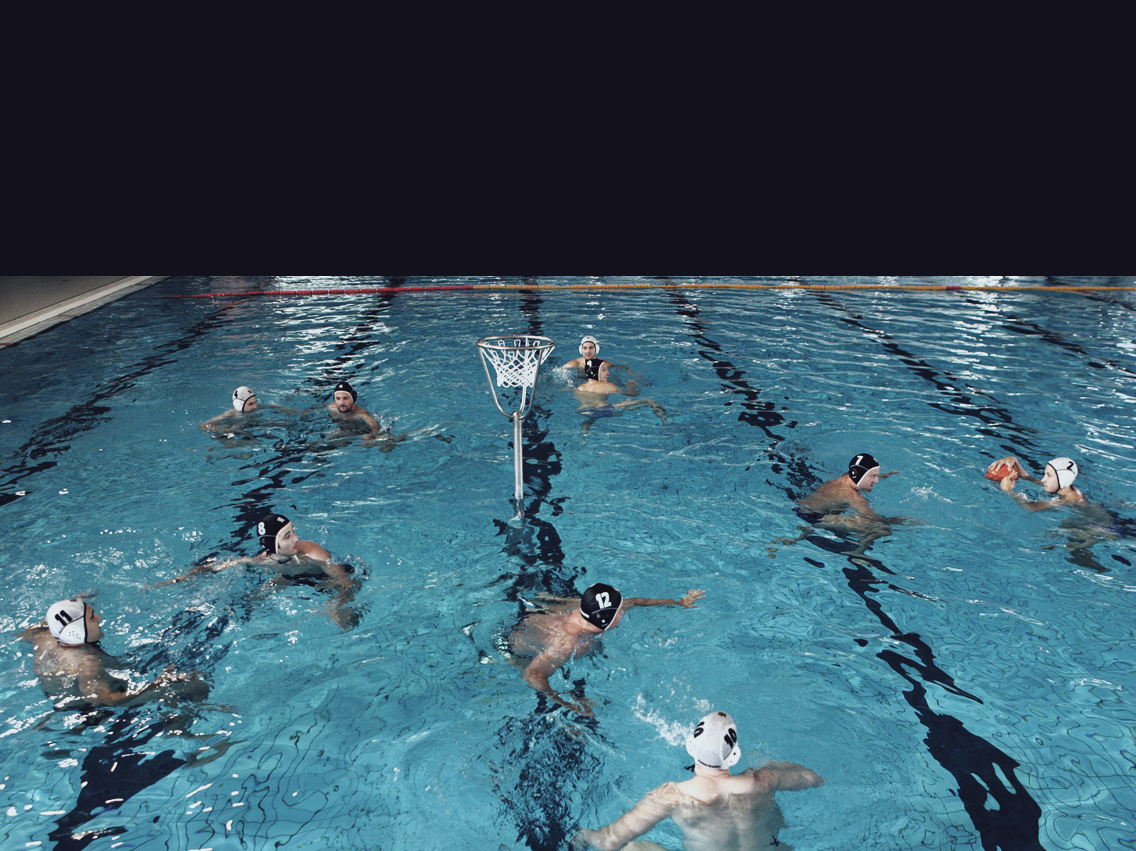
The basic offense position
Five offensive players form a five-star formation around the basket

Slide 14
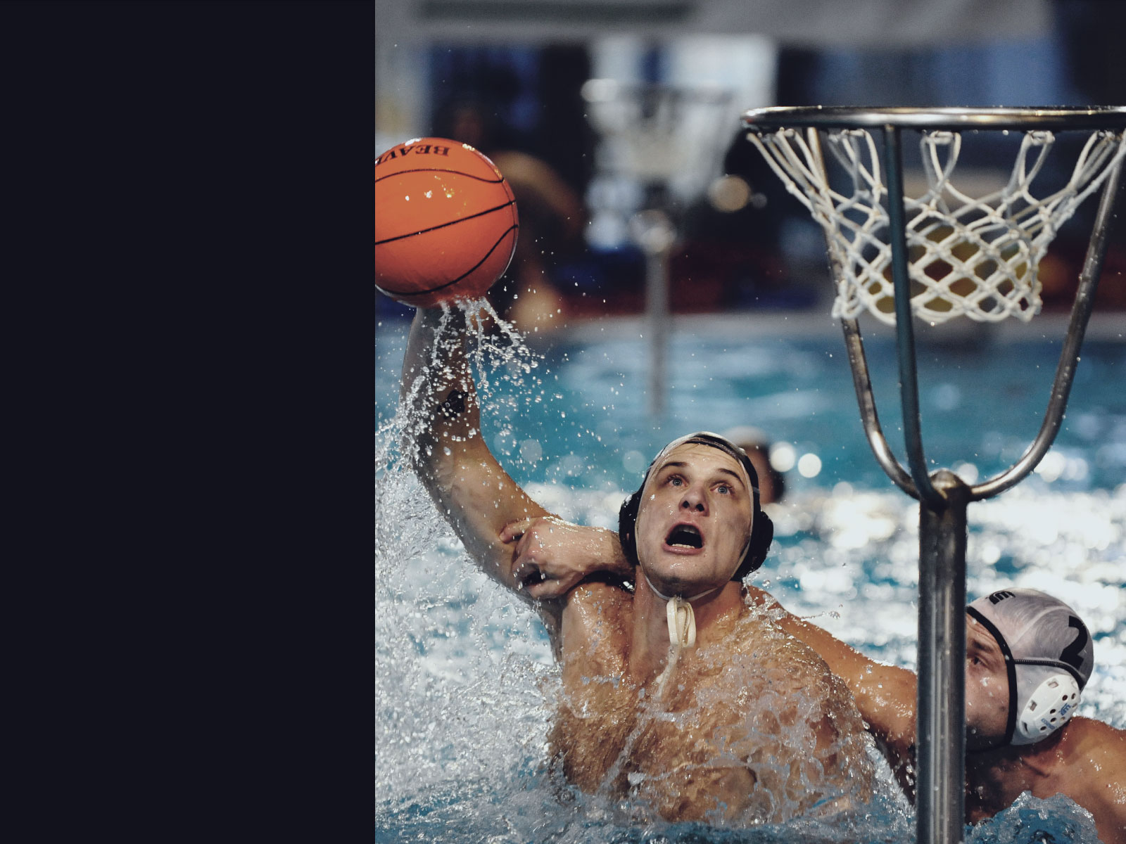
Playing under the
basket
A center player is usually a strong and high player
On the picture you can see a typical personal foul

Slide 15
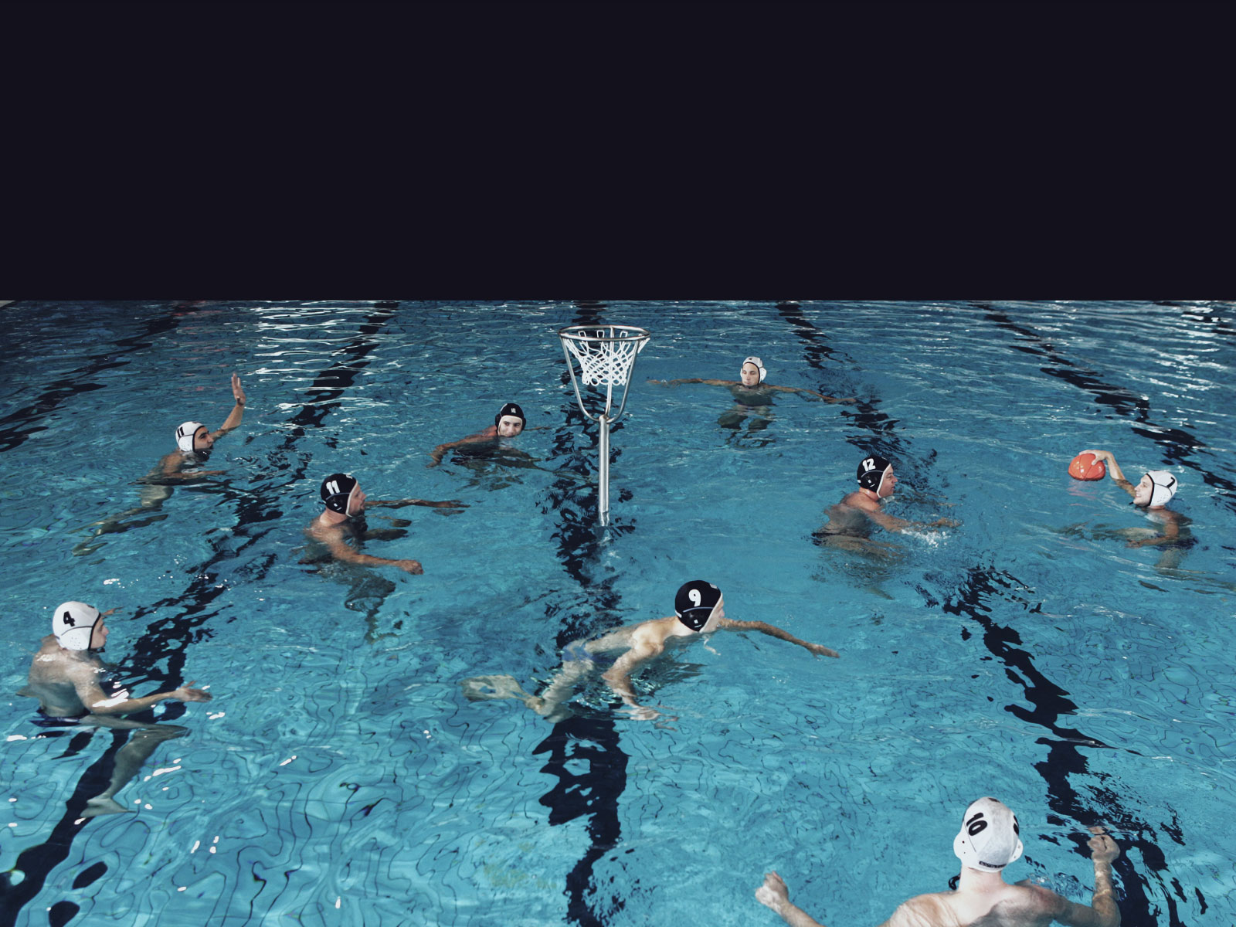
Basic position after exclusion
When a player commits a personal foul in their defensive half of the court, the foul is judged by an exclusion of the player for the time of one attack

Slide 16
Adjustable basket for all ages
With an adjustable steel basket, we are able to adjust the height of the ring above the water surface
That makes an important difference in the game for children, still having the advantage of playing under the basket
When using a women waterpolo ball or even the official size, it is easier for kids to score

Slide 17
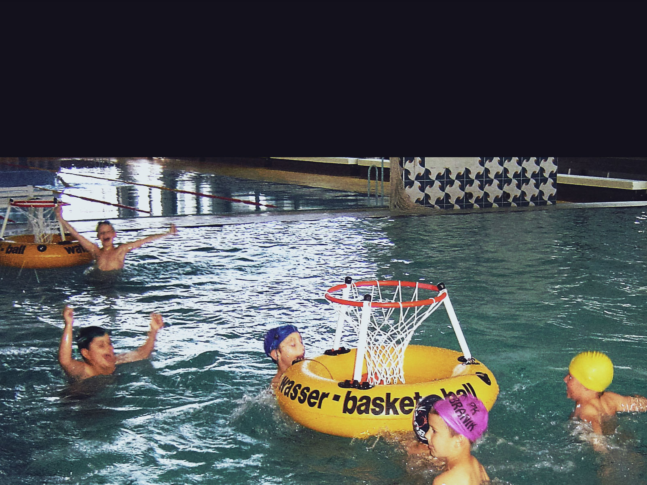
Small kids, shallow pool
The younger kids, that don‘t swimm yet, can play by walking and running on the bottom of the pool with adjusted rules and court dimensions

Slide 18
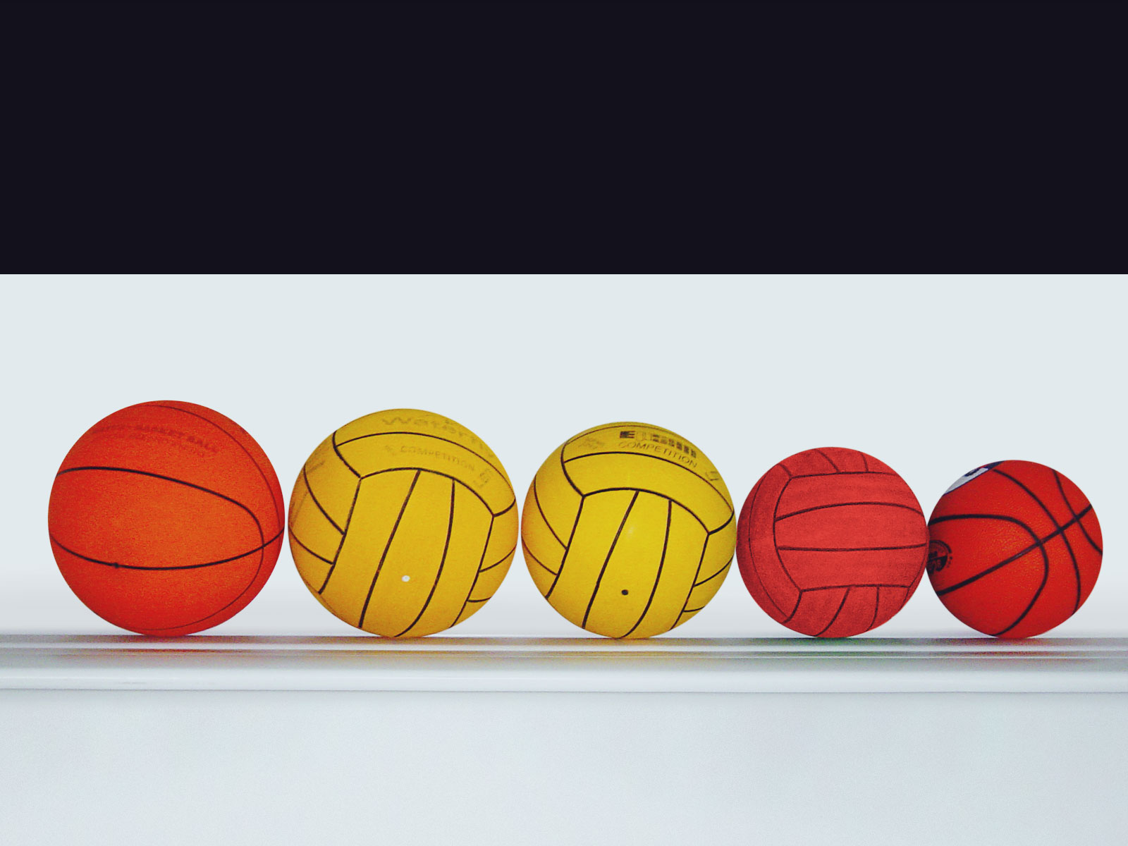
Ball sizes

Slide 19
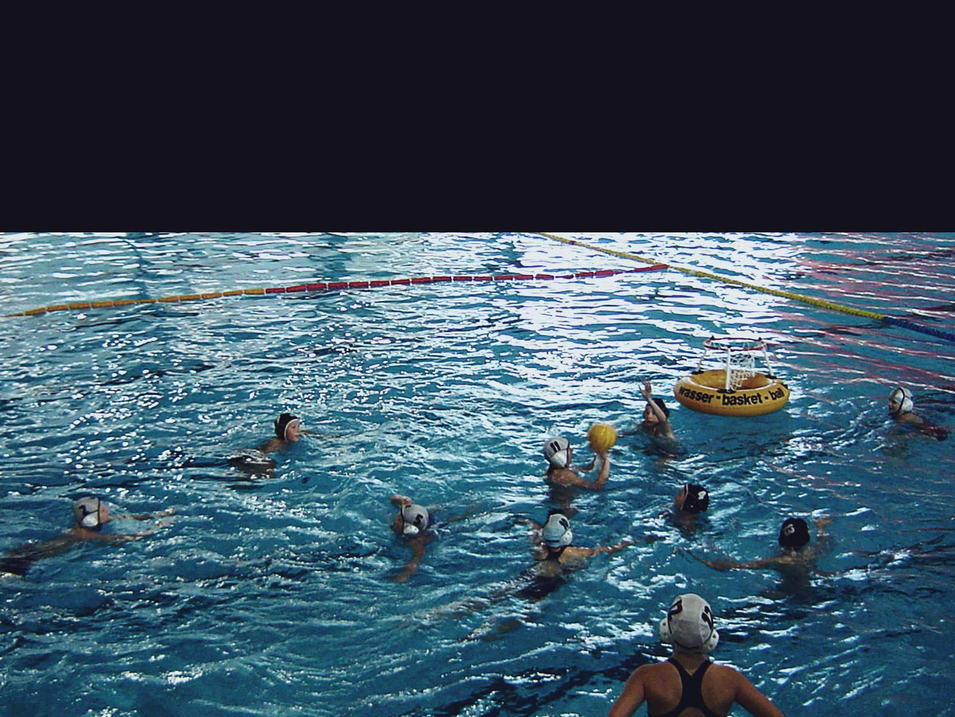
Bigger kids, swimm and play
Kids, that are allready good swimmers play without having a ground stand
They can use a waterpolo ball, for it is smaller and lighter

Slide 20
Why play waterbasketball?
It‘s one of the most healthy sports ever
It‘s for that exciting moment, when the ball falls through the net with a specific sound
It‘s for that glorius feeling you get, when lifting above the water surface to the basket

Slide 21
